Slide 1

Varroa Management Using Drone Brood Removal
Bob Kloss
Northwest New Jersey Beekeepers Association
May 14, 2011

Slide 2

Integrated Pest Management
(IPM)
Multifaceted approach to dealing with pests
Integrate many different management techniques, including physical or mechanical, biological, chemical
NOT eradication:
  Determine tolerable levels of pest populations and permit pests to exist below these levels
  Use the least invasive, injurious or toxic control methods first
LOOK BEFORE YOU TREAT!
Paraphrased from: Simone, Landi. "Integrated Pest Management.pdf." Integrated Pest Management. Essex County Beekeepers, 6/10/2009. Web. 11 May 2011. <http://www.ecbs.njbeekeepers.org/documents/IPM_American_Foulbrood_and_Varroa_Mites_by_Simone.pdf>.

Slide 3
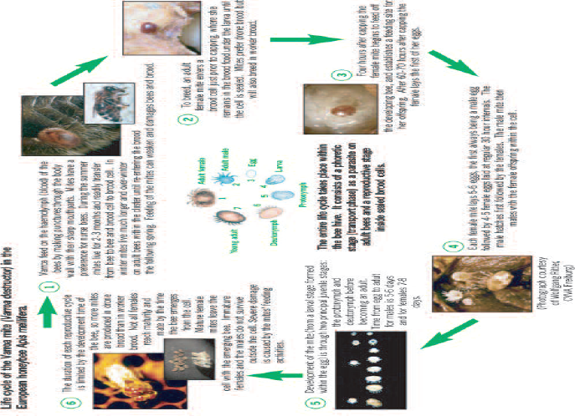
Varroa Life Cycle
From: Department for Environment, Food and Rural Affairs, (defra). "Managing Varroa." www.defra.gov.uk. Crown Copyright, 2005. Web. 11 May 2011. <https://secure.fera.defra.gov.uk/beebase/

Slide 4

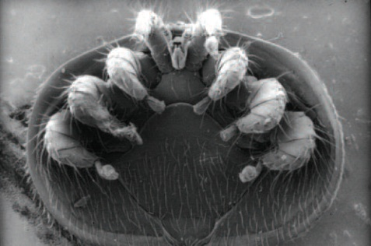
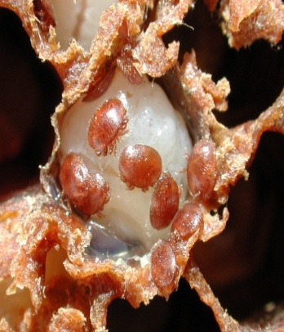
Varroa Facts
Female mites prefer drone brood 10 to 1 over worker brood
Varroa reproduces poorly in worker brood: 3 times more successful in drone brood
Average number of female mites developing:
  Worker cell: 2.2
  Drone cell: 4.4
Summer mites manage 2 reproductive cycles
Mites enter drone cells on days 8 & 9
At 5% drone brood, 50-60 drone cells produce as many mites as 1,000 worker cells
Taken from: Oliver, Andy. "Biotechnical Methods ll - The One-Two Punch@ Scientific Beekeeping." Scientific Beekeeping. Randy Oliver, 12/25/08. Web. 11 May 2011. <http://scientificbeekeeping.com/fighting-varroa-biotechnical-tactics-ii/>.

Slide 5
Bee Math
From: Bush, Michael. "Bee Math." www.bushfarms.com. Copyright Michael Bush, 2006. Web. 11 May 2011. <http://www.bushfarms.com/beesmath.htm>.

Slide 6

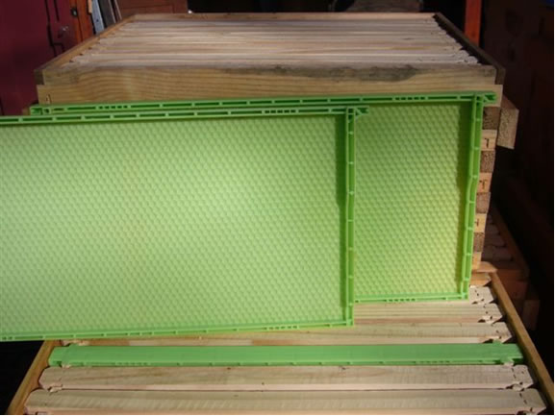
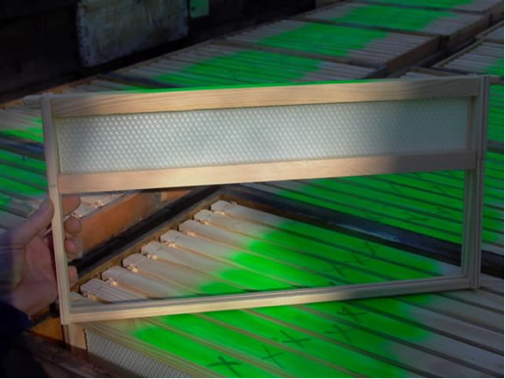
Drone Frames
Plastic Drone Trap Frame
Oliver Drone Trap Frame
Photos from: Oliver, Andy. "Biotechnical Methods ll - The One-Two Punch@ Scientific Beekeeping." Scientific Beekeeping. Randy Oliver, 12/25/08. Web. 11 May 2011. <http://scientificbeekeeping.com/fighting-varroa-biotechnical-tactics-ii/>.

Slide 7
Using Drone Trap Frames
Assume 2 deep brood boxes
Week 1 – Place drone trap frame in bottom box, position 3 or 8
Week 3 – Place drone trap frame in top box, position 3 or 8
Week 5 – Remove drone frame & cut out drone pupae from bottom box; return frame to deep
Week 7 – Remove drone frame & cut out drone pupae from top box; return frame to deep
Repeat every two weeks

Slide 8
When to Use
Treatment | Jan | Feb | Mar | Apr | May | Jun | Jul | Aug | Sep | Oct | Nov | Dec
Screened Bottom Board
Drone Brood Removal
Artificial Swarm
Comb Trapping
Apiguard/formic acid
Bayvarol/Apistan
Lactic/oxalic acid
Table from: Department for Environment, Food and Rural Affairs, (defra). "Managing Varroa." www.defra.gov.uk. Crown Copyright, 2005. Web. 11 May 2011. <https://secure.fera.defra.gov.uk/beebase/

Slide 9
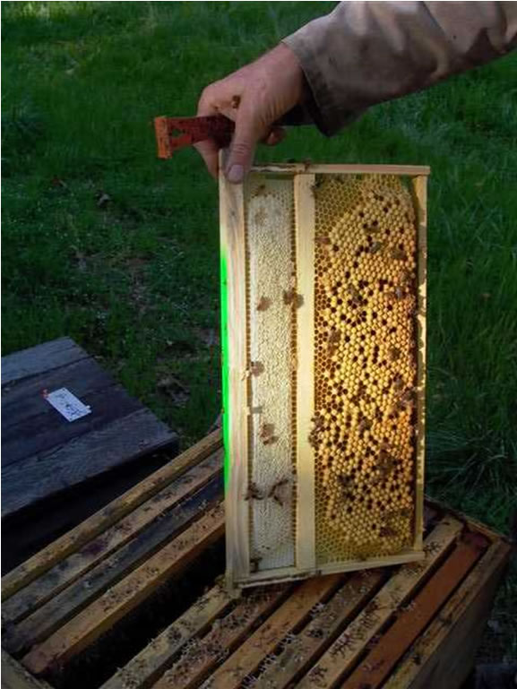
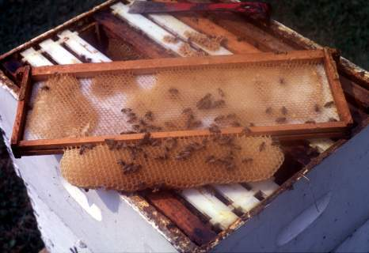
Drone Frames at 4 Weeks
Photos from: Oliver, Andy. "Biotechnical Methods ll - The One-Two Punch@ Scientific Beekeeping." Scientific Beekeeping. Randy Oliver, 12/25/08. Web. 11 May 2011. <http://scientificbeekeeping.com/fighting-varroa-biotechnical-tactics-ii/>.

Slide 10
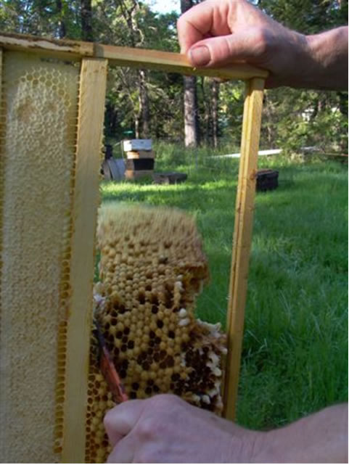
Removing Capped Brood
Photo from: Oliver, Andy. "Biotechnical Methods ll - The One-Two Punch@ Scientific Beekeeping." Scientific Beekeeping. Randy Oliver, 12/25/08. Web. 11 May 2011. <http://scientificbeekeeping.com/fighting-varroa-biotechnical-tactics-ii/>.

Slide 11
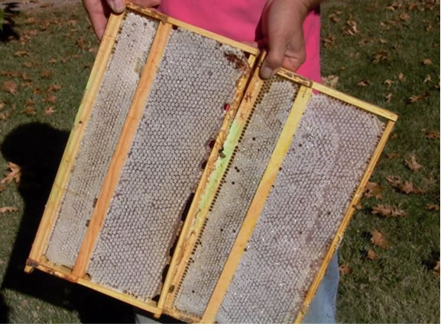
Drone Frames - End of Season
Photo from: Oliver, Andy. "Biotechnical Methods ll - The One-Two Punch@ Scientific Beekeeping." Scientific Beekeeping. Randy Oliver, 12/25/08. Web. 11 May 2011. <http://scientificbeekeeping.com/fighting-varroa-biotechnical-tactics-ii/>.

Slide 12
Benefits
French study*: Drone trapping 4 times in a season reduced mites by 25%
  Honey production did not suffer
  Controlled swarming
‘Manage’ where the colony builds drone comb
* Cited in: Oliver, Andy. "Biotechnical Methods ll - The One-Two Punch@ Scientific Beekeeping." Scientific Beekeeping. Randy Oliver, 12/25/08. Web. 11 May 2011. <http://scientificbeekeeping.com/fighting-varroa-biotechnical-tactics-ii/>.

Slide 13
Drawbacks
Labor intensive
Exerts constant selection against mites that prefer drone brood
  Need to breed for VSH behavior
Don’t forget to remove the frames at 4 weeks or you will be breeding mites!

Slide 14
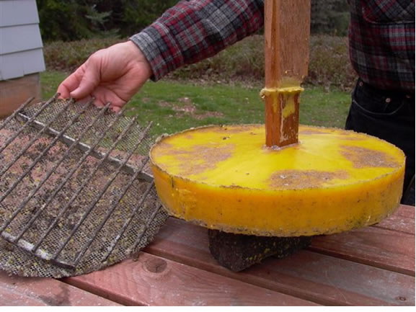
Other Benefits - Wax
Photo from: Oliver, Andy. "Biotechnical Methods ll - The One-Two Punch@ Scientific Beekeeping." Scientific Beekeeping. Randy Oliver, 12/25/08. Web. 11 May 2011. <http://scientificbeekeeping.com/fighting-varroa-biotechnical-tactics-ii/>.

Slide 15
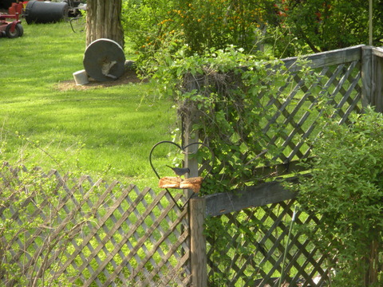
More Benefits - Bird Food
Photo courtesy of NWNJBA member Roger Gares

